Slide 1

SOULAID
Eng/Omnia Alaa

Slide 2

Introduction
Donation Management Systems
Focuses on collecting and managing financial and in-kind resources to support individuals and communities in need.
Aims to make donation processes more transparent and efficient through technology.
Crucial in humanitarian crises and charitable efforts.

Slide 3

Database

Slide 4
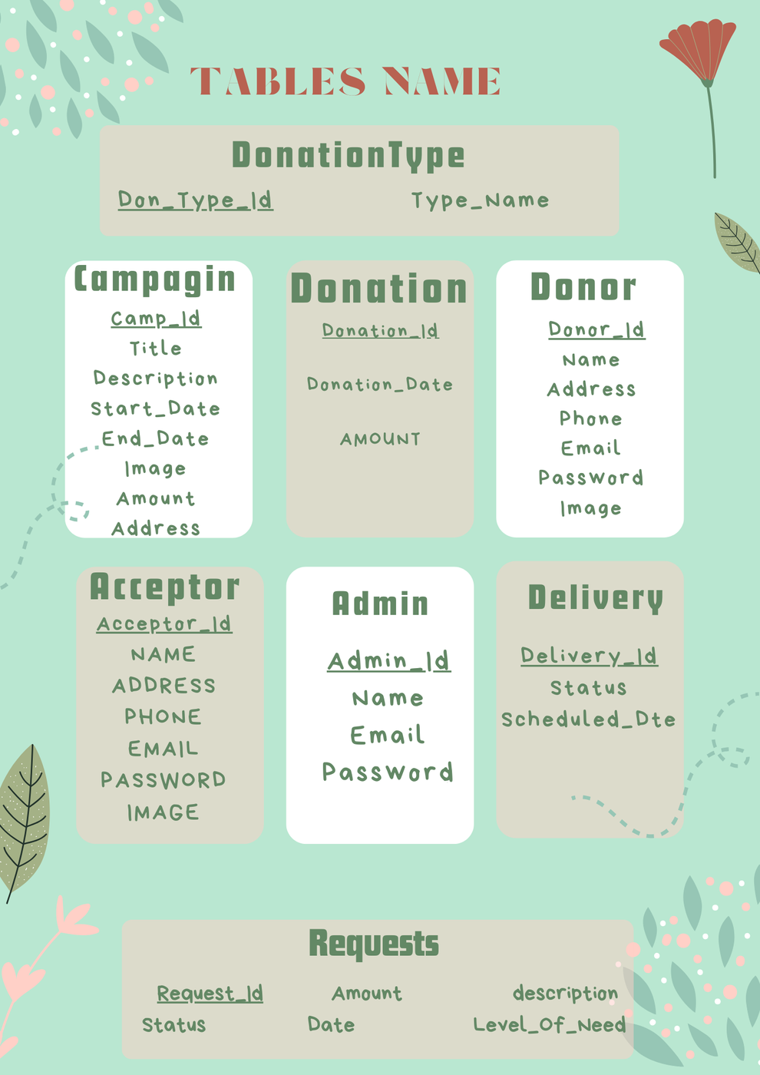


Slide 5

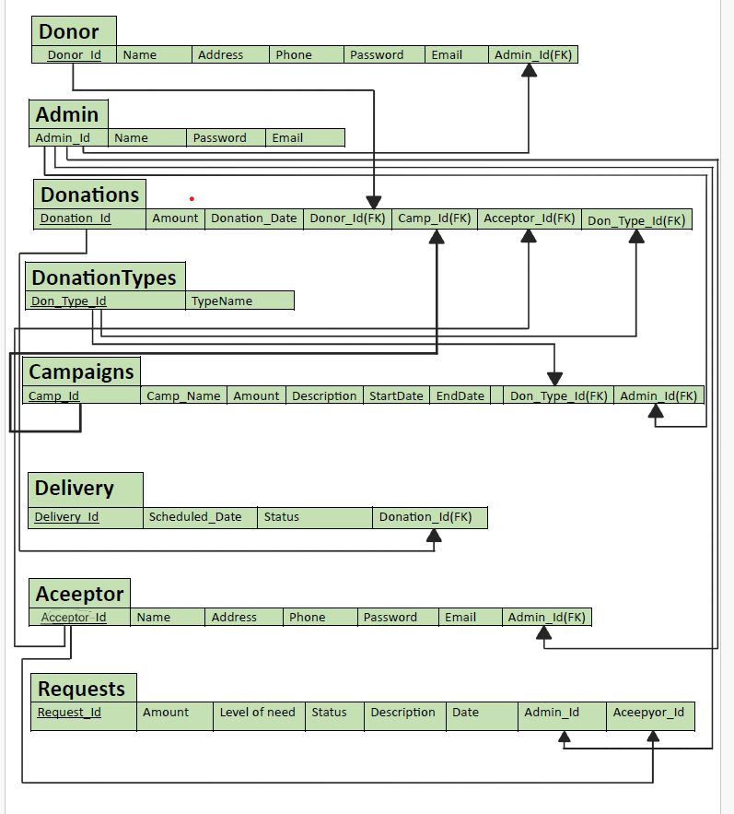

Slide 6
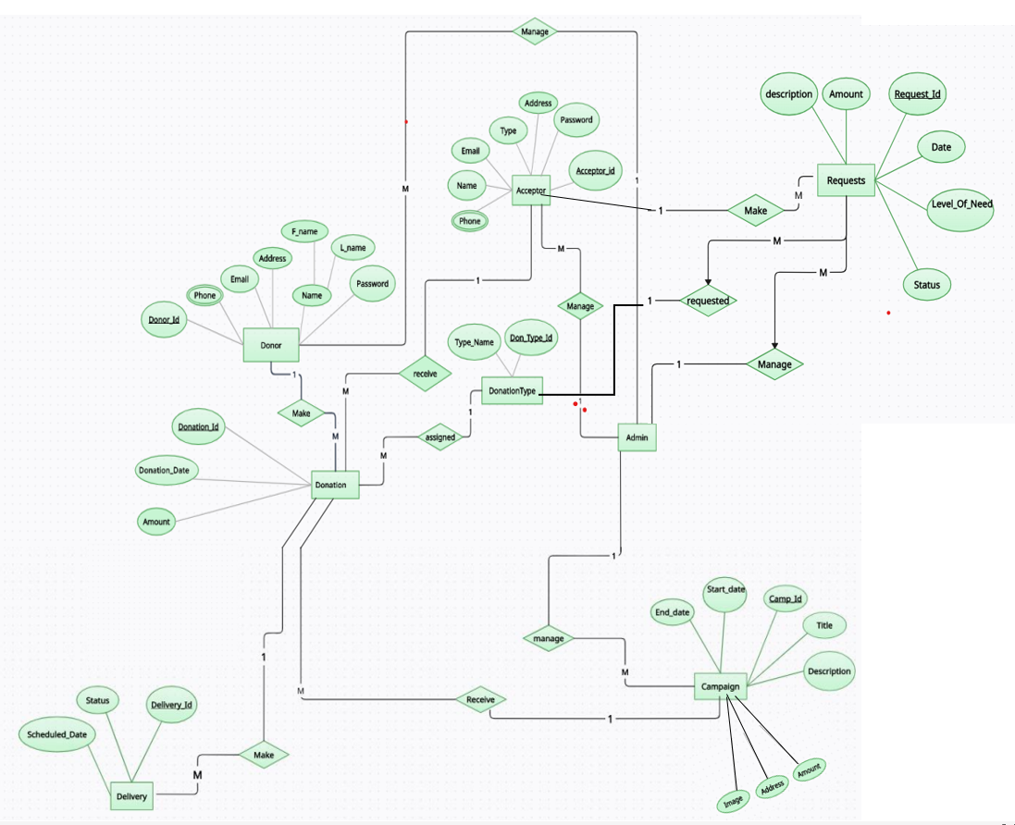

Slide 7
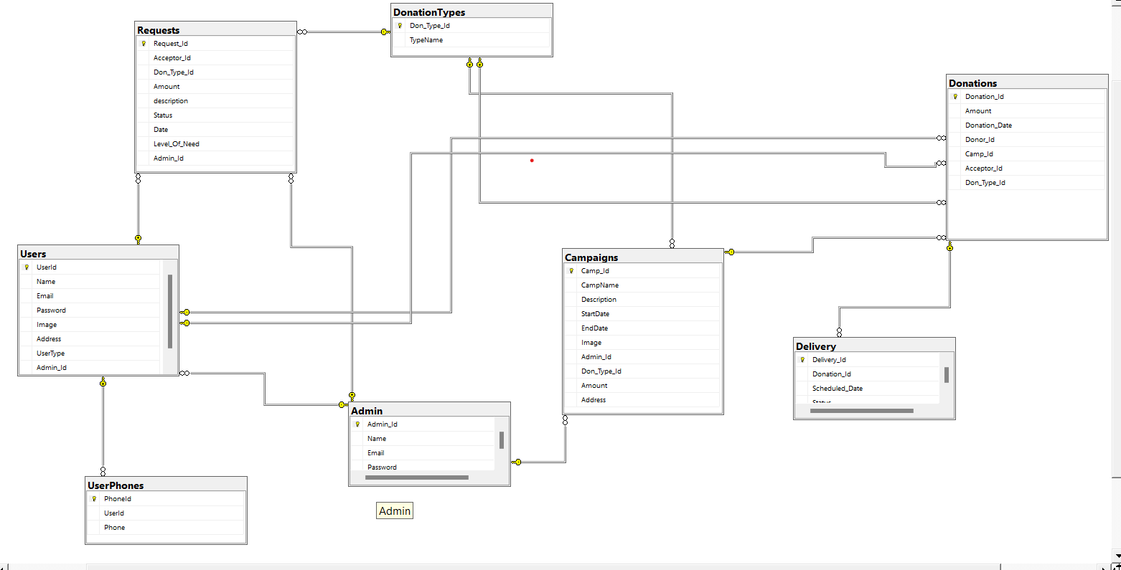

Slide 8
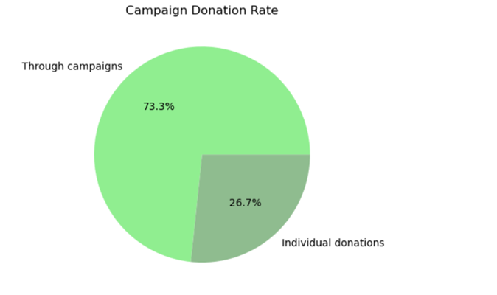
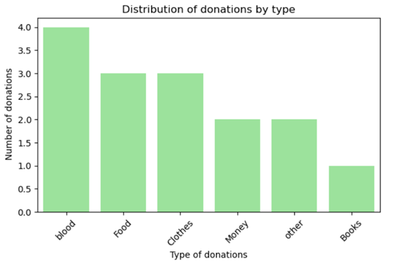
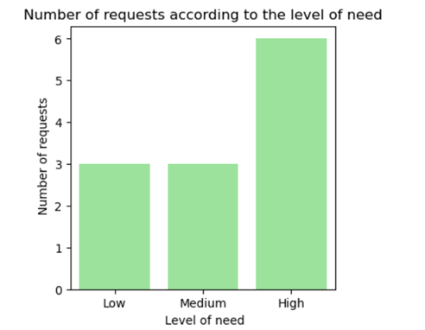
Data analysis

Slide 9
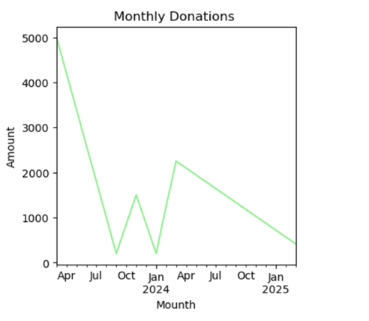
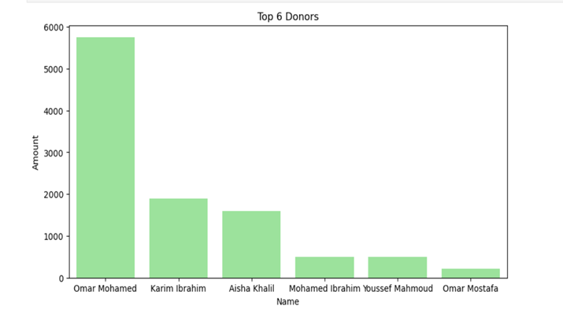
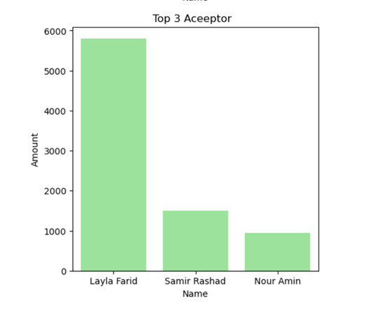
Data analysis

Slide 10
Thank You

